Slide 1

Career Cluster 101 –
Big Sky Pathways
Big Sky Pathways Institute
Best Western Butte Plaza Inn – Butte, MT
October 16, 2008

Slide 2

Discussion Topics
Career Clusters
Big Sky Pathways
Getting Started: Six Steps
Benefits
Montana Resources
Notes:
We will specifically discuss these eight topics.

Slide 3
How Were Career Clusters Developed?
U.S. Department of Education
National Association of State Directors of Career Technical Education Consortium
National Advisory Committees
  Business and Industry
  Labor
  Government
  Education (secondary and postsecondary)

Slide 4
Career Clusters: Tool
for a seamless educational system that:
  Blends rigorous academic/technical preparation
  Provides career planning
  Offers options for students to experience all aspects of an industry
  Facilitates/assists students with transitions
Notes:
4
Career Clusters serve as a tool for connecting academic, technical and employability skills, in conjunction with learners’ career planning. Career Clusters serve as a framework, or a model to help learners transition from one educational level to another. For example, clusters help to connect career exploration in middle school with in-depth exposure to a cluster in 9th and 10th grade, moving to more specific skills in secondary and postsecondary education/training. Career Clusters also serve as a tool for connecting an adult’s existing skills with new/emerging job opportunities as well as identifying new skill sets that need to be added to existing skills.

Slide 5
Career Clusters: Why?
Sources of Competitive Advantage
  Business agility
  Product and process innovation
Transition to New Workplaces (Figure 1)
Careers and Learning
  Vertical and horizontal mobility
  Self-directed career and learning management
Notes:
5
Now that we know a little bit more about “what” a Career Cluster is, for the next few minutes let’s talk about the “why”. Why do we even need Career Clusters? We are moving to a knowledge-based economy where businesses need to be able to change direction quickly. Eighty percent of all jobs in America require the use of technology.

Slide 6
Figure 1: Transition to 21st Century Workplaces
 | From: | To:
Management Functions | Centralized/Separated | Decentralized/Shared
Professional/Technical Knowledge | Centralized/Specialized Some Workers | Decentralized/Integrated All Workers
Work Design | Jobs | Functional/ Cross-functional Teams
Organizational Structure | Vertical Hierarchies | Customer-Supplier Networks
Employee Responsibility Management | Job Task Performance | Work Unit Performance Business Process
Career Progression | Vertical Limited Range | Vertical and Horizontal Full Range

Slide 7
Why Career Clusters/Pathways?
Vehicle to integrate academic and technical content
Vehicle to support seamless transitions
Assures currency in changing labor market
Stretches us to support the entire economy
Increase rigor, relevance and relationships

Slide 8
New Model for Career Education
Why the Change?
Vocational Education | Career Education
For some students | For all students
Some jobs | All careers
6-7 Disciplines | 6 Career Fields/16 Clusters
In lieu of academics | Align with & support academics
High school focused | K-12 & postsecondary focused

Slide 9
What Career Clusters DON’T Do
Do not take away current programs
Do not take away occupational areas
Do not track learners into a single job
Notes:
9
Career Clusters provide a framework that can be used to strengthen and enhance existing programs such as [insert applicable career and technical program titles familiar to your audience]. Career Clusters help prepare learners for careers, not just an entry level job.

Slide 10
What Career Clusters DO
Provide a framework for program development
Provide a framework for seamless education
Provide a framework for addressing the entire world of work
Provide a picture of how Knowledge and Skills transfer vertically and horizontally
Provide MORE career options for learners
Notes:
10
Career Clusters can be a powerful tool to organize instruction and career development. Learners start with a broad base of interest as well as knowledge and skills and progress to a more focused area of study. We’ll talk about this more in the next few slides.

Slide 11

What about Career Pathways?
A Career pathway represents a grouping of occupations within a cluster based on commonalities

Slide 12
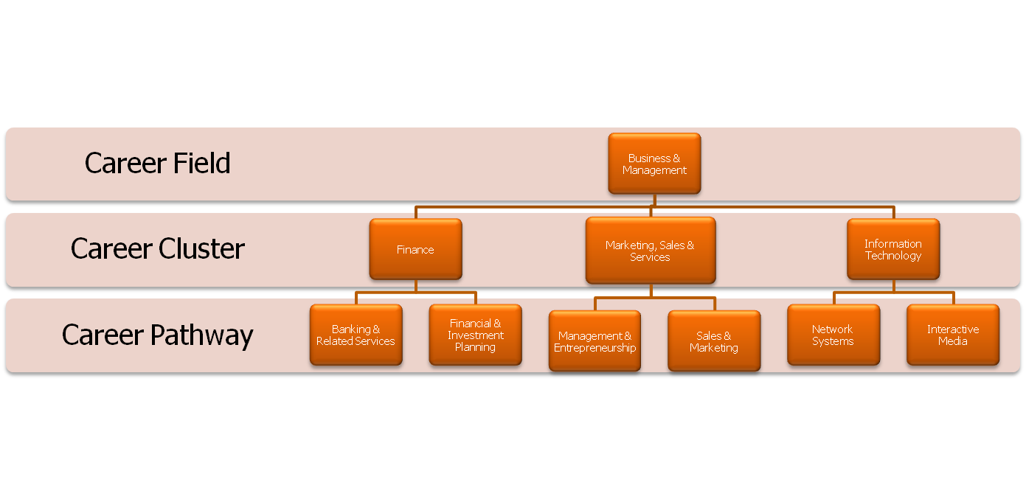
Example of Career Terms

Slide 13
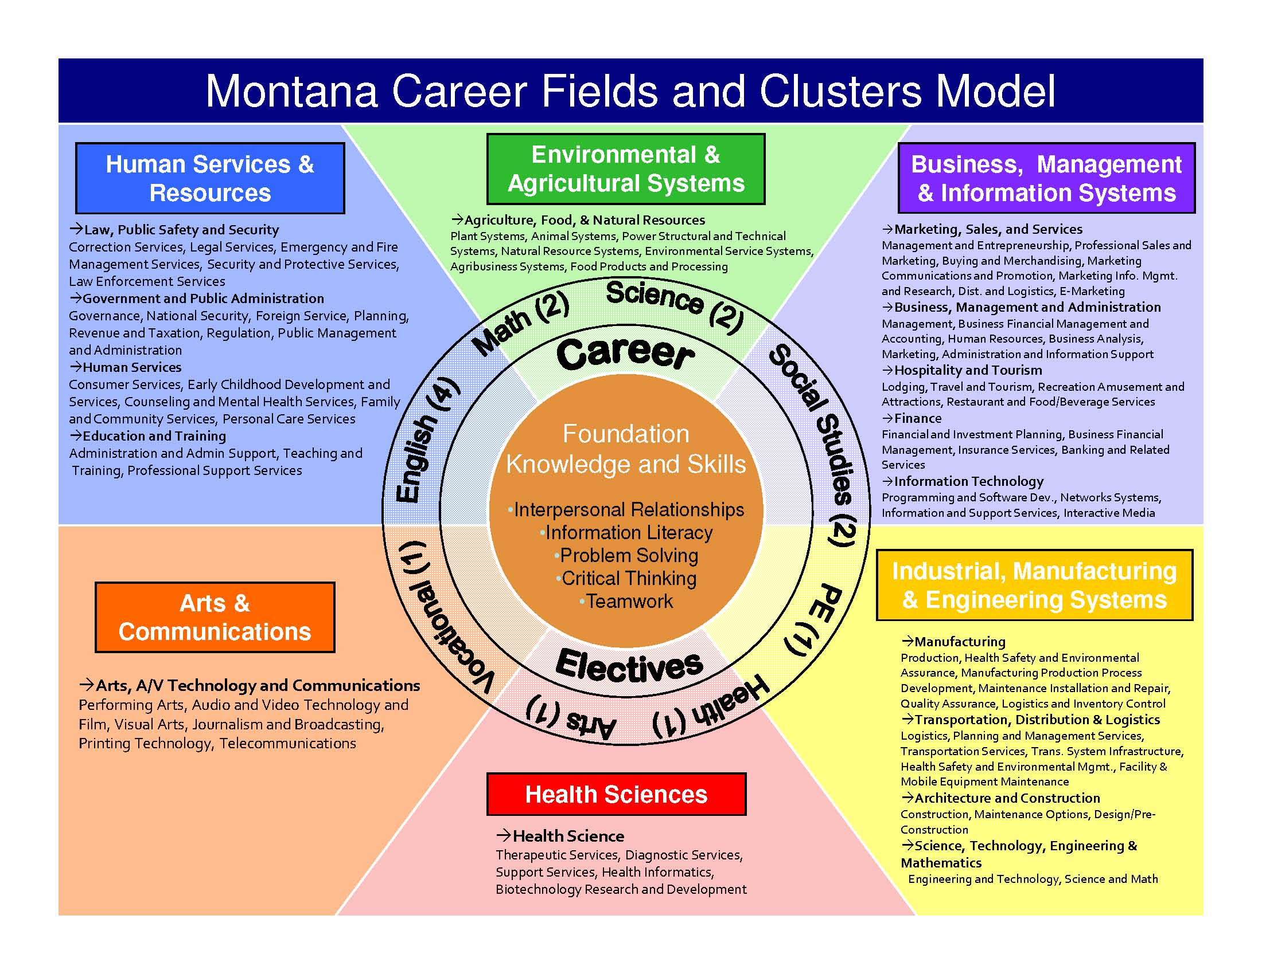

Slide 14








What will be required?
Each local program is required to implement at least one career pathway/model sequence of course.

Slide 15







What is it?
CAREER PATHWAY OR MODEL SEQUENCE OF COURSES
MUST INCLUDE:
  a coordinated and non-duplicative sequence of courses
  both secondary and postsecondary education elements;
  challenging academic and career and technical education content and
  culminate in technical skill proficiency, an industry-recognized credential, a certificate, a degree, or completion of a recognized apprenticeship program.
MAY INCLUDE:
  opportunity for secondary students to participate in dual or concurrent enrollment programs or other ways to acquire postsecondary credits

Slide 16
What about Small Schools?
A Career pathway in a class B school could look like this…
Three pathways and a sequence of courses in each pathway.
Cluster
Business Management
and Information Systems
Core Class or
Prerequisite
Information Systems
Interactive Media
Finance
Accounting I
Info Systems II
Web Design I
Accounting II
Business Office Skills
Web Design II
Accounting III
Business, Man. & Admin

Slide 17
Cluster
Environmental and
Agricultural Systems
Food Products & Processing
Animal Systems
Agribusiness Systems
Plant Systems
Core Class or
Prerequisite
Introduction to Agriculture
Agriculture Science
Agriculture Welding
Agriculture Auto
Agriculture Engineering
Agriculture Machine Shop
Agriculture Construction
Agriculture Business
Power, Structural & Technical Systems

Slide 18
Cluster
Health Sciences
Core Class or
Prerequisite
Biology
Therapeutic Services
Biology II
Chemistry
Pharmacy Technician

Slide 19
What about Small Schools?
A Career pathway in a class C school could look like this…
Two pathways and a sequence of three courses in each pathway.
Cluster
Business Management
And Information Systems
Core Class or
Prerequisite
Office Technology
Finance
Business, Mgmt. & Admin.
Accounting I
Principles of
Business I
Accounting II
Principles of
Business II

Slide 20
Plan of Study
A sequenced listing of courses, both academic and CTE/degree major, that connects student’s high school ad postsecondary educational experiences
  Business Management and Information Systems
  Environmental and Agricultural Systems
  Health Sciences
Notes:
20
The next module in this Tool Kit will address the implementation of the Career Clusters Framework. Here are just a few starting pointers…

Slide 21
Getting Started: Six Steps
Recognize the need for school-wide change
Involve the community
Involve Counselors
Build staff capacity
Identify career themes
Develop advisory boards
Focus on professional development
Notes:
The next module in this Tool Kit will address the implementation of the Career Clusters Framework. Here are just a few starting pointers…

Slide 22
Okay, Now What?
Some Recommendations. . . . .
Link Career Technical instruction to a career theme
Strengthen the senior year
Make sure instruction relates to the students’ career interests and aspirations

Slide 23
Benefits
Learners
Faculty/Teachers
Schools/Colleges
Parents
Business
Postsecondary
Counselors

Slide 24
Resources
www.careerclusters.org
  Preferred Product/Technical Assistance Providers
  Brochures
  Career Clusters Resources CD
  Posters
  Pathway Models
  Plans of Study
  Interest Inventory
  Tour Guide
  Career Clusters Journey
Annual Career Clusters Institute
www.careervoyages.com
Notes:
There are many resources available to help you learn about and utilize Career Clusters. Go to these Web sites for free or inexpensive aids, including the Pathway Models for all 16 clusters. Plans of Study are available for each Career Cluster to serve as a guide for helping students plan their courses of study. These are Word documents that can be customized to meet the needs of your educational and socioeconomic system.

Slide 25
The Journey Begins …
A journey of a thousand miles begins with a single step.
Lao-tzu (604 BC - 531 BC), The Way of Lao-tzu

Slide 26
Contact Information:
Mark Branger
mbranger@huntley.k12.mt.us
Cheryl Graham
cgraham@nemontel.net
www.montanaacte.org

Slide 27
What is CTE?
Change in definition to eliminate the focus on sub-baccalaureate careers (does not impact $)
Dual preparation for postsecondary education and employment
Not just ‘job’ preparation but ‘academic and technical’ preparation
Increased emphasis on attainment of a technical skill proficiency, degree, certificate or credential

Slide 28
Local Plans
Provide at least one CTE program of study
Describe how local recipients will encourage students to take “rigorous and challenging” core academic courses
Programs aligned to rigorous technical standards
All aspects of the industry
Size, scope and quality

